Slide 1
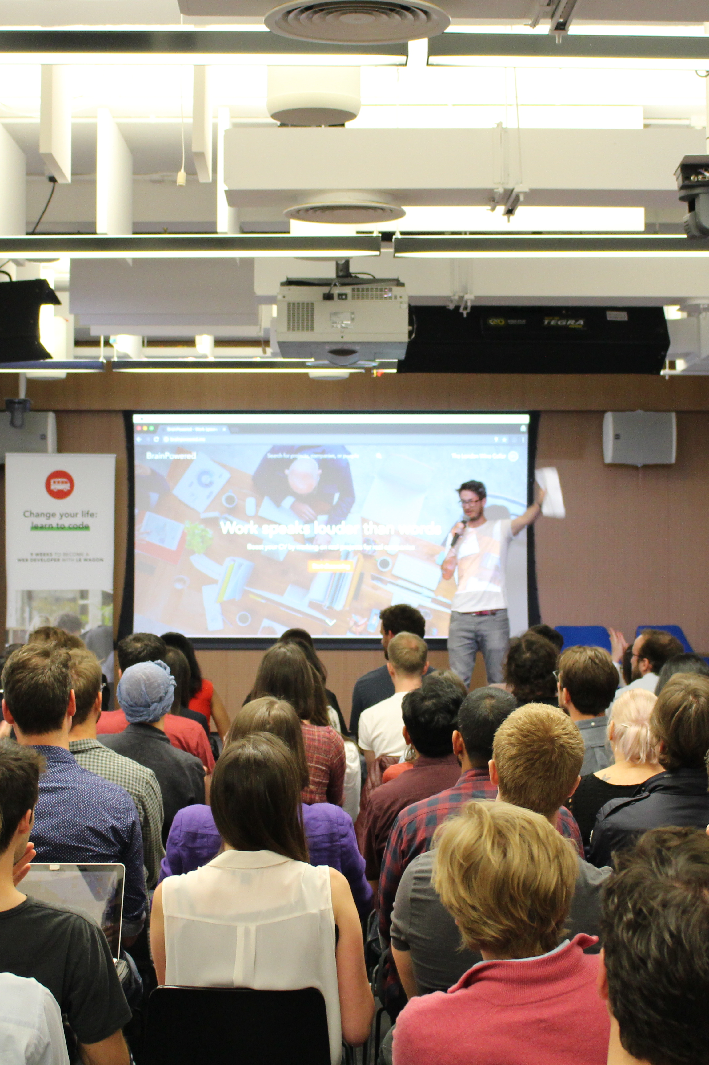

Pitch prep.
FAQ on Pitches / Projects

Slide 2


Projects week
Week 8 & 9

Slide 3
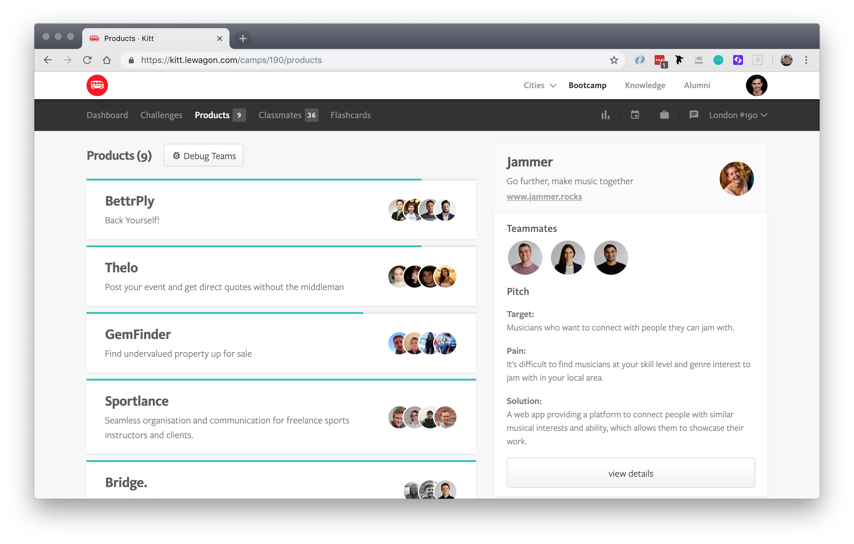

How do
projects
work?
- Teams of 3 or 4
- 41 students
- 11 to 13 projects
- One goal: LEARN

Slide 4
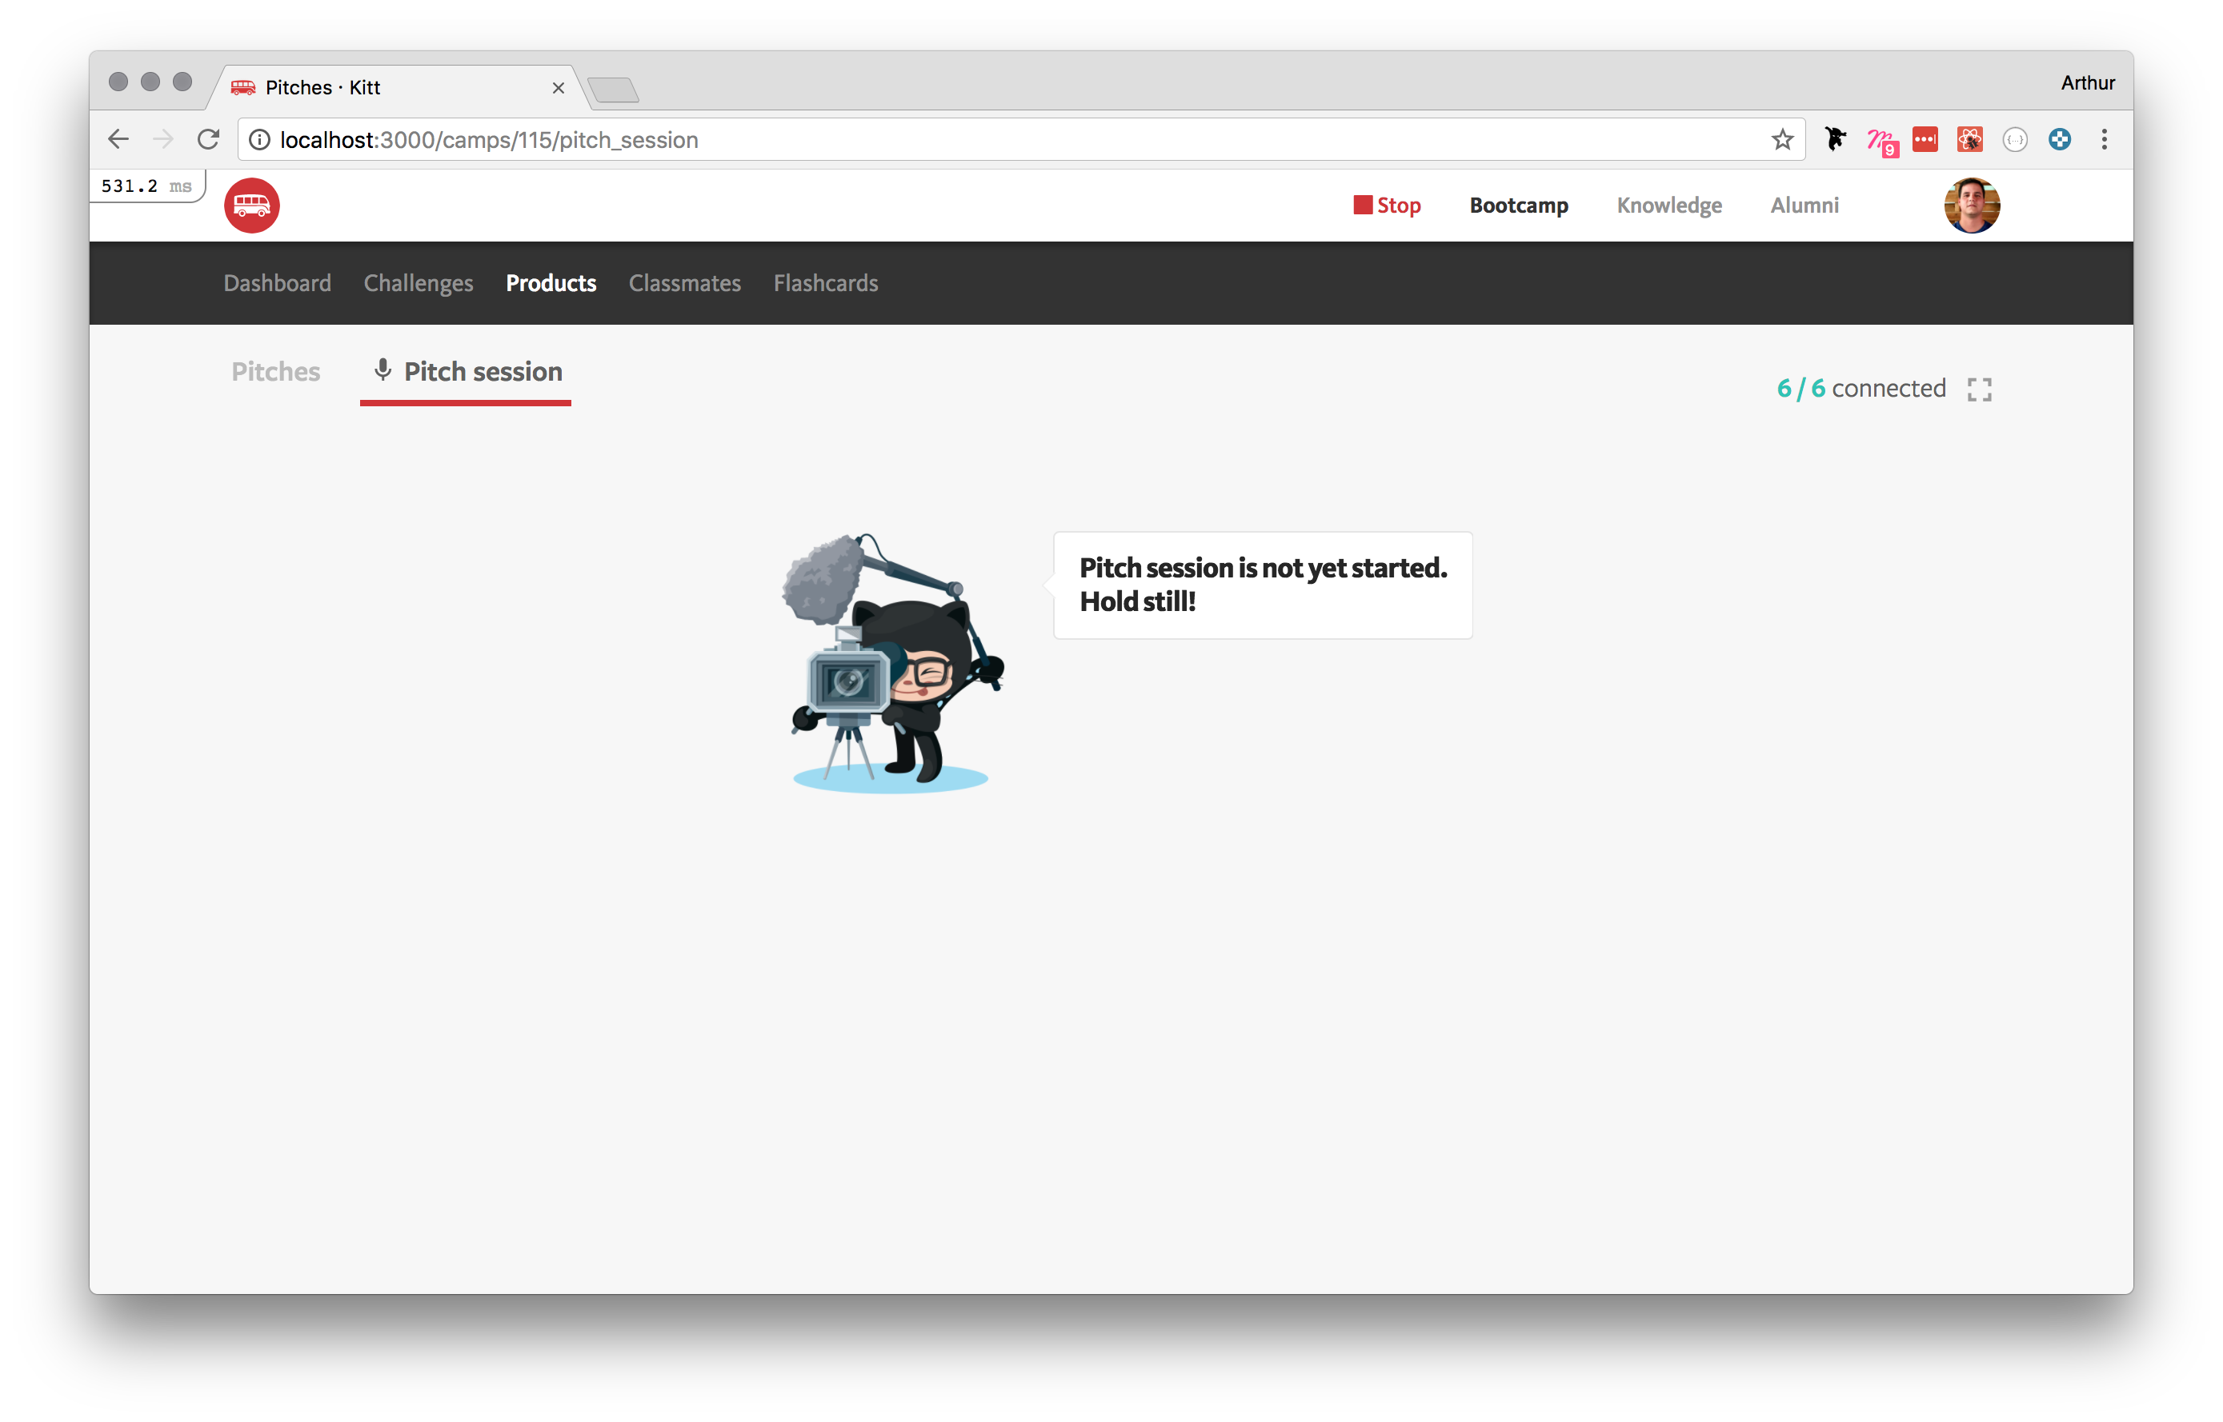
FAQ for
pitch
day.
- Everyone with laptops
- 3 min pitches
- 3 slides (target, pain, solution)

Slide 5
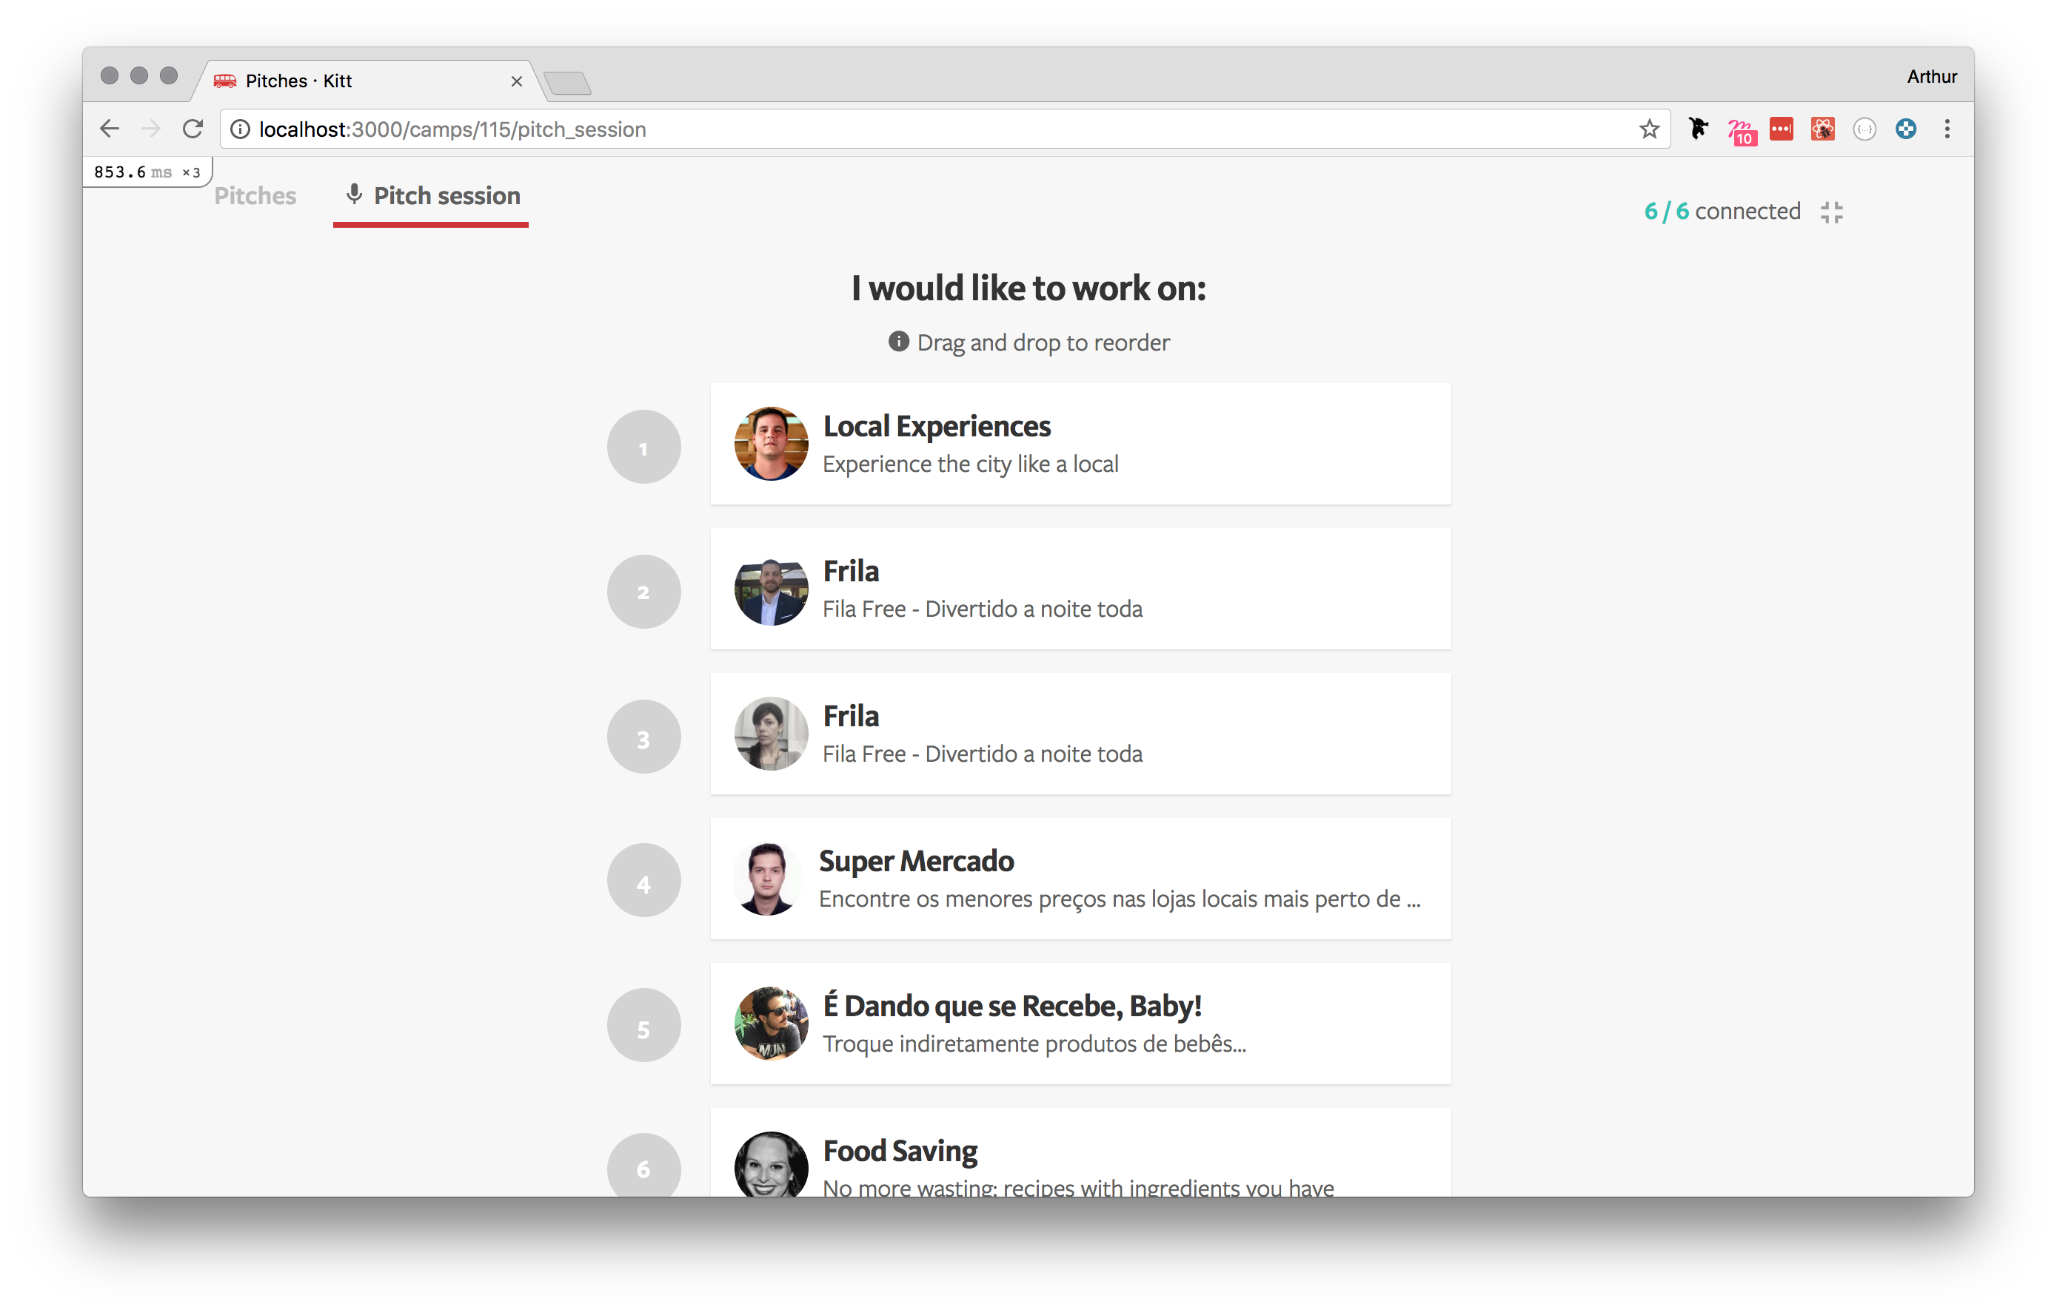
After all
pitches.
- 15 min to discuss
- Make you wishlist

Slide 6
What’s a good project?
Make the most of week 8 & 9
How to choose the right product to work on!

Slide 7

Le Wagon 21.06.2018
What makes a project
good
Avoid marketplaces ⛔️
Challenging feature 💪
Airbnb week 7 / Boring
Live interaction, video, etc.
Creativity possible 🤩
Simple user journey 👩‍💻
Admin == Boring frontend
Few pages

Slide 8
What’s a good pitch?
Make your pitch stand out!

Slide 9
Le Wagon 21.06.2018
What makes a pitch
good
Obvious pain 🤕
Short slides 🤯
Makes a clear product
Say it rather than write it!
Be passionate 🤩
Core vision 🔭
People will believe you
Explain clearly what
you want to build

Slide 10
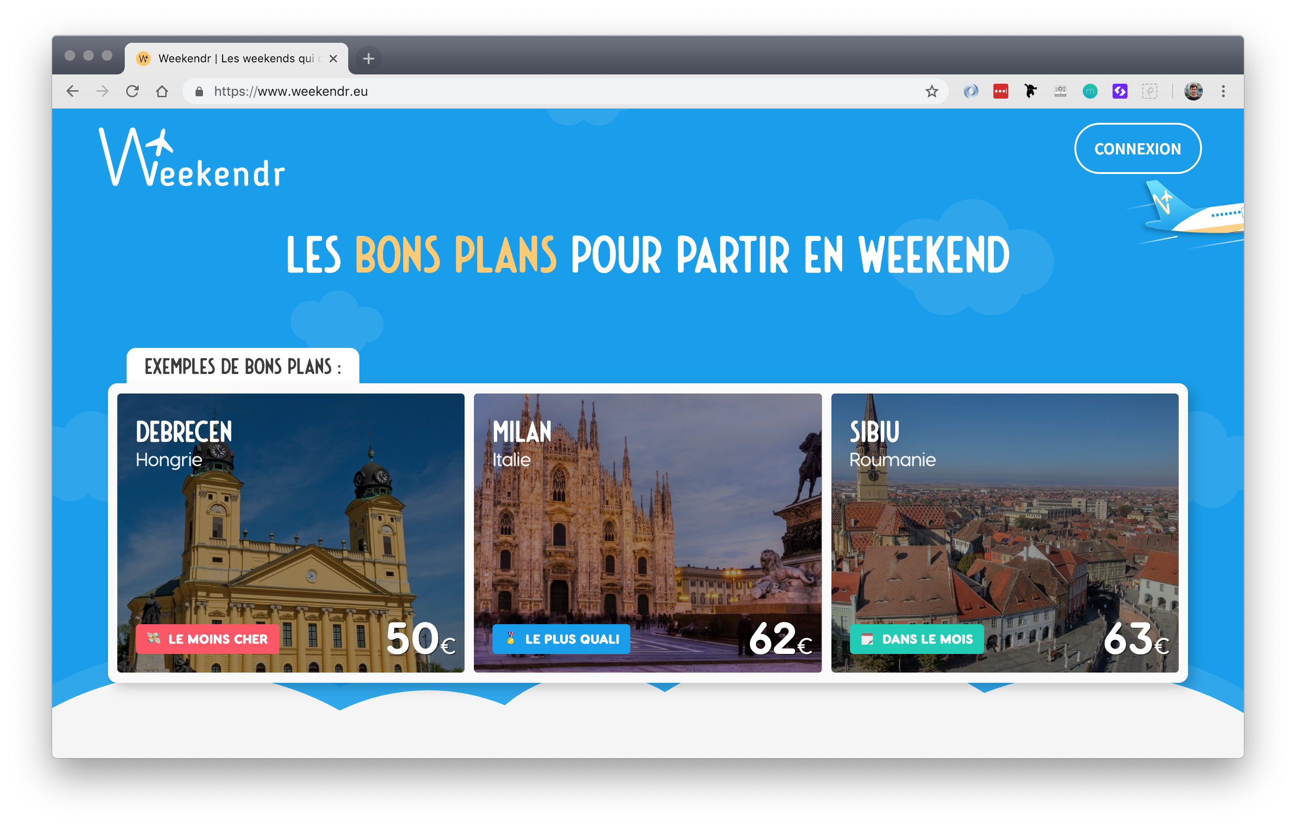
Weekendr
Example of a great pitch

Slide 11
Their
pitch.
Pain
Target
Solution
It takes a whole afternoon to find cheap flights for weekends on comparison sites.
Young professional who want to visit a specific city but don’t care which weekend.
Flight comparison site only for long weekends

Slide 12
Le Wagon 21.06.2018
Any
questions?

